Slide 1
Learning: Supervised, Unsupervised and Reinforcement
Santosh GSK
Industry Expert

Slide 2
Agent Architecture Recap
Simple Reflex Agent
Model based Agent
Goal based Agent
Utility based Agent
Learning based Agent

Slide 3
Agent Architecture Recap
Simple Reflex Agent
Model based Agent
Goal based Agent
Utility based Agent
Learning based Agent

Slide 4
Learning agent
An agent is learning if it improves its performance on future tasks after making observations about the world
Learning happens through observations, i.e., data

Slide 5
Why Learning?
The agent designer cannot anticipate all possible world states the agent need to handle and code them in the agent environment
E.g., A robot designed to navigate mazes need to learn the layout of new maze whenever encountered
The agent designer cannot anticipate all changes over time
E.g., Stock market prediction
Sometimes the agent designer have no idea how to program a solution
E.g., Stock market prediction

Slide 6
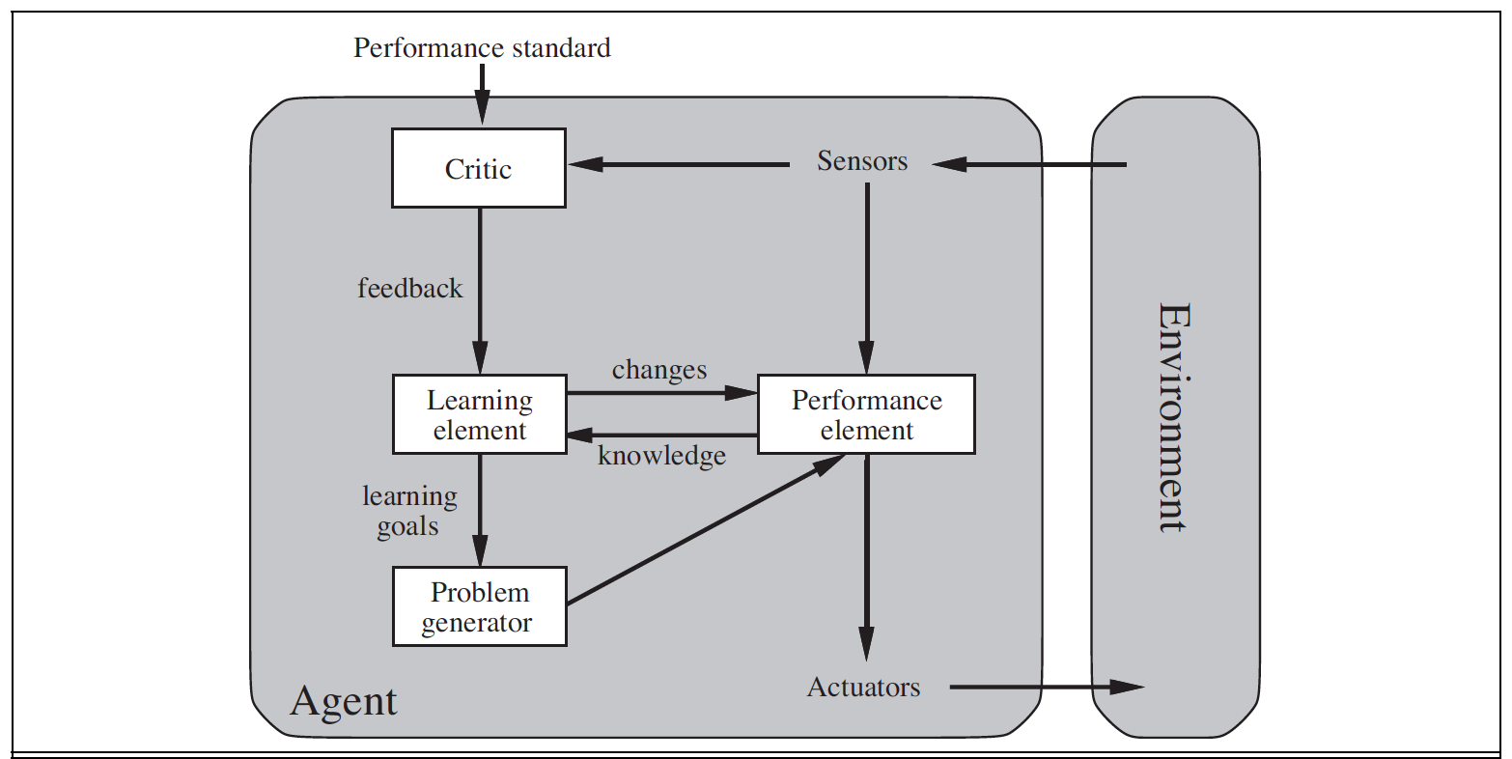
Learning Agent

Slide 7
Learning Agent Components
Performance Element – taking a decision of action based on percepts
Learning Element – Make the performance element select better actions such that the utility function is optimized
Critic – Provides feedback on the actions taken
Problem Generator – Make the Performance Element select sub-optimal actions such that you would learn from unseen actions

Slide 8
Learning Element - Feedback
There are three (3) types of feedback that determine the learning form
Supervised – Feedback will be provided for every action suggesting the correct action
E.g., In a Spam Classifier, if the agent tags an email as Spam, the Feedback says whether it is actual Spam or Not. Can be multiple classes.
Reinforcement – Feedback will be provided for a collection of actions suggesting whether the end state is desirable (reward) or not (punishment)
Doesn’t mention the corrective actions
E.g., Two points at the end of a chess game would tell the agent it did something right but the agent has to figure out which actions are responsible.
Unsupervised – No feedback. The agent need to figure out patterns.
Clustering related news articles in Google news

Slide 9
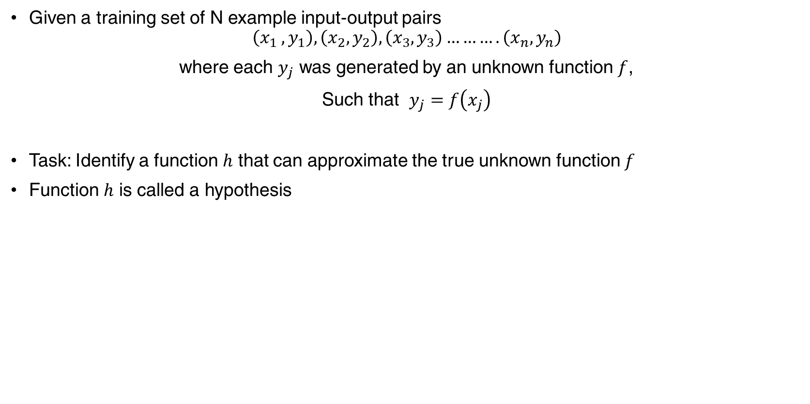
Supervised Learning
Given a training set of N example input-output pairs
$$\left(x_{1} ,y_{1}\right), \left(x_{2},y_{2}\right), \left(x_{3},y_{3}\right)……….\left(x_{n},y_{n}\right)$$
where each $y_{j}$ was generated by an unknown function $f$,
Such that $y_{j}=f\left(x_{j}\right)$
Task: Identify a function $h$ that can approximate the true unknown function $f$
Function $h$ is called a hypothesis

Slide 10
Supervised Learning
Learning is the task of searching through the space of possible hypothesis using the given examples (train set) such that
The hypothesis performs well on a unseen set of observations, called test set
Generalization: The ability of a hypothesis to perform the correct prediction on unseen observations.
The higher the better

Slide 11
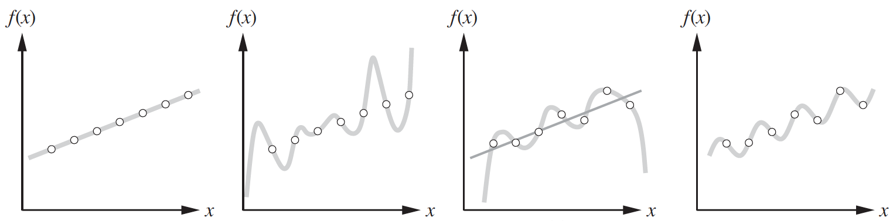
Hypothesis Space

Slide 12
Supervised Learning
Types of Supervised Learning
Classification
Regression

Slide 13
Classification
When the variable to predict (y) is discrete real-valued variable
E.g.,
Will there be any rainfall today or not (Yes / No)
Classify an image as fruit, vegetable or a place, etc.
Algorithms:
Decision Trees
Logistic Regression
SVM
Neural Networks

Slide 14
Decision Tree
It is the most simple yet most powerful algorithm in machine learning
Let us first describe the Hypothesis Space and then learn a good hypothesis

Slide 15
Decision Tree
Input: A vector of attribute values
Output: A ”decision” - single output value
E.g., [1.2, 3, ’a’, 4] -> “spam”
Decision Tree: A tree consists of nodes and directed edges where decisions are made at each node on selecting a child branch.
Decisions are made by a test on one of the input attribute values
Each leaf node will be the return value

Slide 16
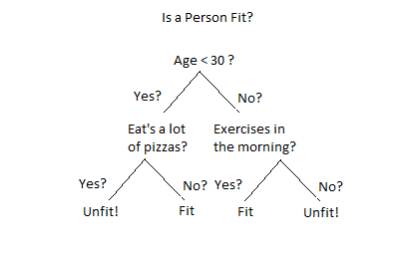
Decision Tree

Slide 17
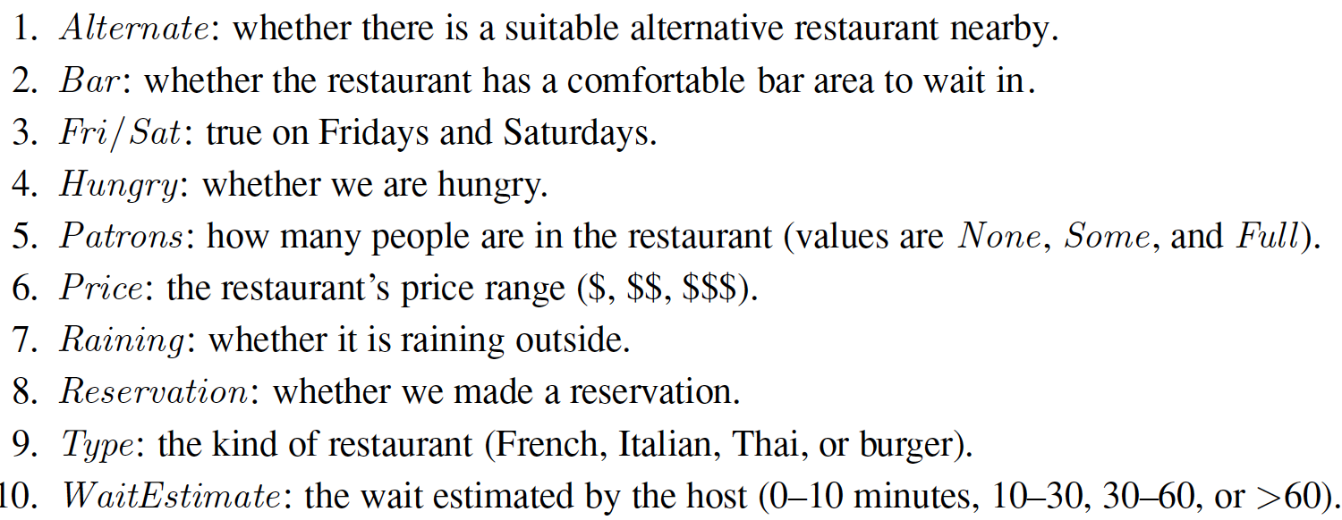
Decision Tree Building
Let us build a decision tree to decide whether to wait for a table at a restaurant
Dependent Variable to predict: WillWait (Yes / No)
List of attributes that may be predictive of our dependent variable

Slide 18
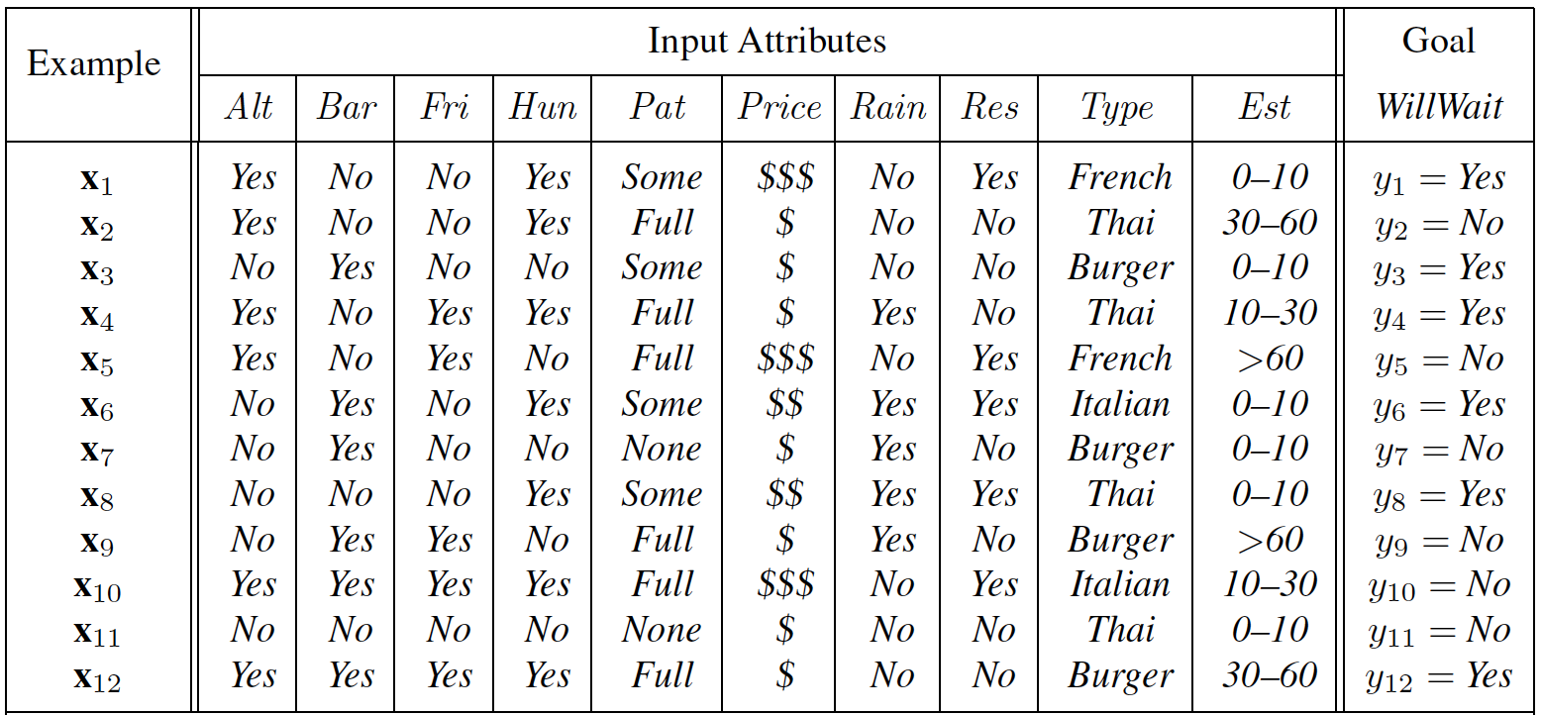
Decision Tree

Slide 19
Decision Tree
End goal: A tree that is consistent with the examples and is as small as possible
However, finding the true smallest tree that is consistent is intractable because of possible combination of trees to search
Hence, goal is to find a good approximate solution

Slide 20
Decision Tree Learning
Adopts a greedy divide-and-conquer strategy
Always test the most important attribute first
Most important attribute: One that makes most difference to classification
This test divides the problem into sub problems that can be solved recursively

Slide 21
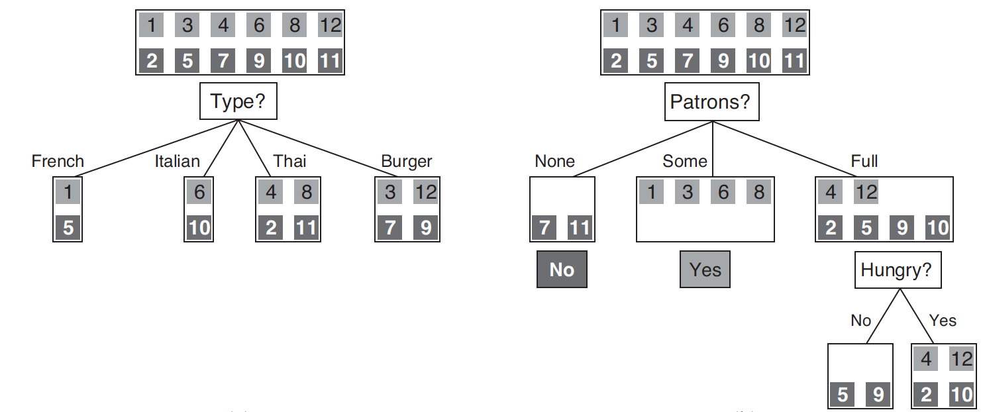
Decision Tree Learning

Slide 22
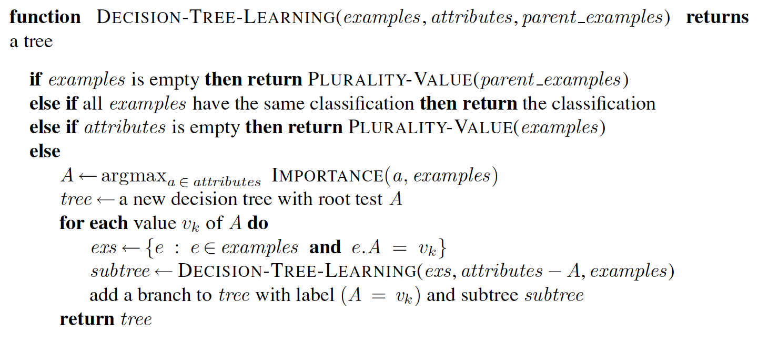
Decision Tree Learning Algorithm

Slide 23
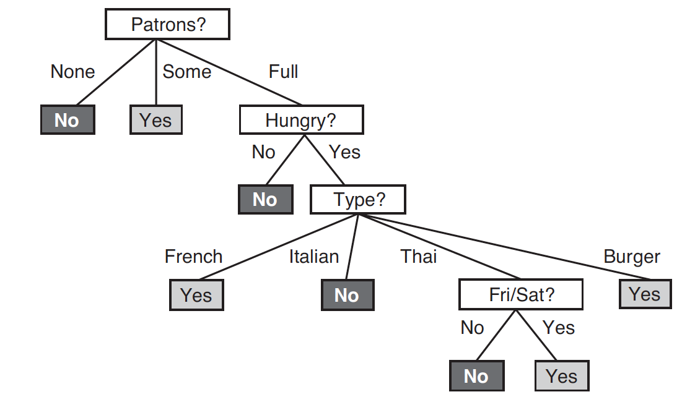
Decision Tree

Slide 24
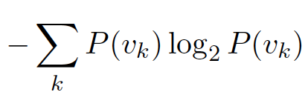
Attribute Tests
Need to measure IMPORTANCE of each attribute at a node
Entropy: Measure of randomness
E.g., After deciding to use Attribute A and value B, we get a set S with WillWait class values [Yes, No, No, Yes].
There is high degree of randomness compared to [Yes, Yes, Yes]
Entropy H(V) of random variable V with values v_{k} is measured as
Where P(v_{k})is the proportion of the value, e.g., P(v_{yes}) = 0.5, P(v_{no}) = 0.5 in [Yes, No, No, Yes]

Slide 25
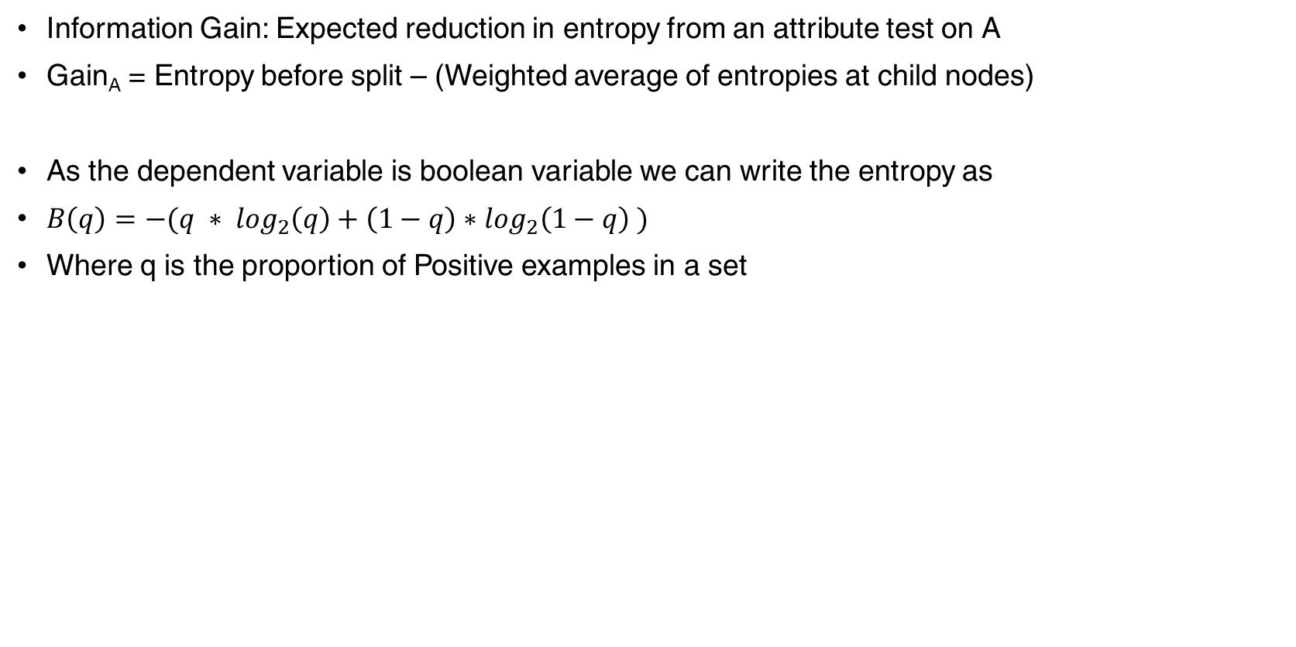
Attribute Tests
Information Gain: Expected reduction in entropy from an attribute test on A
Gain_{A} = Entropy before split – (Weighted average of entropies at child nodes)
As the dependent variable is boolean variable we can write the entropy as
$B\left(q\right)=−(q ∗ \log_{2}\left(q\right)+\left(1−q\right)∗\log_{2}\left(1−q\right) )$
Where q is the proportion of Positive examples in a set

Slide 26
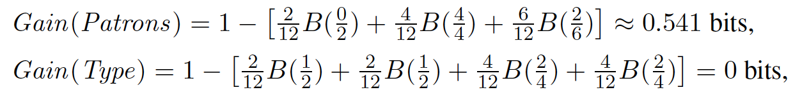
Information Gain
Entropy before = 1
As there are equal number of positive and negative samples
- Log₂ 0.5 = 1

Slide 27
Evaluation
Loss function
How far are the predicted values from the true values?
In most algorithms, the parameters are selected by optimizing the loss function
Evaluation Metrics
How well are our predictions serving the purpose?
A reporting number measuring the goodness of our model

Slide 28
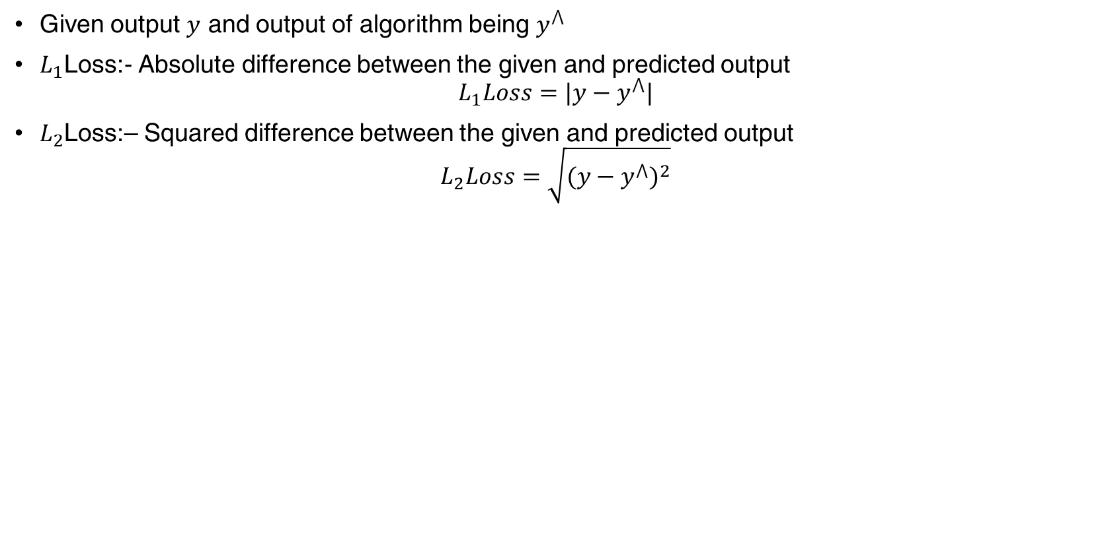
Loss Function
Given output $y$ and output of algorithm being $y^{⋀}$
$L_{1}$Loss:- Absolute difference between the given and predicted output
$$L_{1}Loss=|y−y^{⋀}|$$
$L_{2}$Loss:– Squared difference between the given and predicted output
$$L_{2}Loss=\sqrt{{(y−y^{⋀})}^{2}}$$

Slide 29
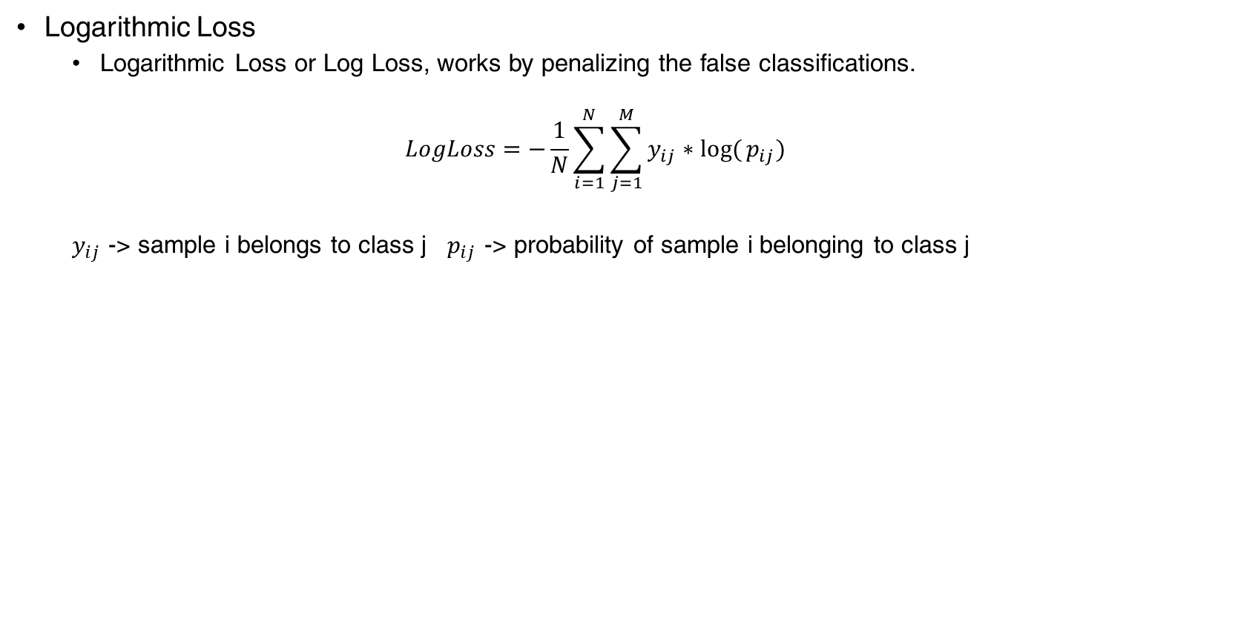
Loss Function
Logarithmic Loss
Logarithmic Loss or Log Loss, works by penalizing the false classifications.
$$LogLoss=−\frac{1}{N}\sum_{i=1}^{N}{\sum_{j=1}^{M}{y_{ij}∗log⁡(}p_{ij})}$$
$y_{ij}$ -> sample i belongs to class j $p_{ij}$ -> probability of sample i belonging to class j

